Slide 1
SFWR TECH 4DA3
Big Data
Instructor: Dr. Jeff Fortuna, B. Eng, M. Eng, PhD, (Electrical Engineering), McMaster University
email: fortunjj@mcmaster.ca

Slide 2
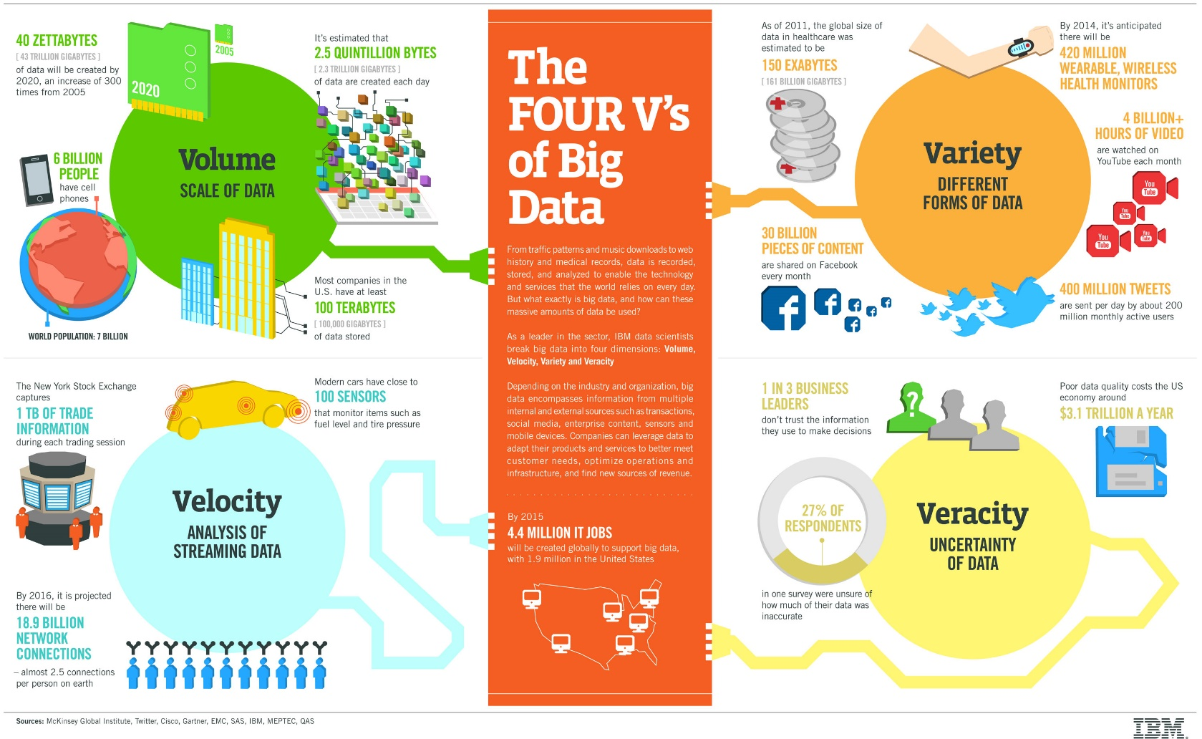
What is it? The 4 v’s of Big Data
Data that has
  Volume
  Velocity
  Variety
  Veracity

Slide 3
Two Important Issues in General…
Infrastructure (operational concerns)
Analysis (Data Mining)
I will look at each separately in this discussion

Slide 4
Why new infrastructure for Big Data?
Because of the 4 v’s.
SQL (and the associated infrastructure) is not well suited (as was NOT designed with Big Data in mind
Specifically:
  Cloud computing causes big problems with distributed joins and data consistency
  Data is often unstructured
  Data demands change rapidly, requiring alteration of the schema

Slide 5
A Possible Answer is NoSQL
A common organization is the Document Database (there are others…)
The “document as an object” is a natural way of grouping data
Data is very often already stored as a “document” so no additional schema is required to define the structure
The document objects have variable structure – this is fundamentally different from a relational database with a defined schema
To address the 4 v’s, data consistency is often sacrificed in favor of availability and speed

Slide 6
Big Data Systems
Some examples:
https://www.capterra.com/big-data-software/
There are a LOT of choices…
That is why it makes very little sense to study any one of them. The best that can be done is to understand commonalities.

Slide 7
What factors are involved in making a decision about which system to use?

Slide 8
Big Data Analytics
First, please read:
https://hbr.org/2013/12/you-may-not-need-big-data-after-all
IMHO, the most important quote is:
“most companies don’t do a good job with the information they already have. They don’t know how to manage it, analyze it in ways that enhance their understanding, and then make changes in response to new insights. Companies don’t magically develop those competencies just because they’ve invested in high-end analytics tools”

Slide 9
Data Analytics Tools
Many of the example big data systems software come with analytics tools.
The tools are a superset of what we have covered in this course
I don’t advise using any tool unless you understand how it works and what it is giving you as a result.
Any of the approaches we covered can be applied to big data systems

Slide 10
So, what is different about Big Data from an analytics perspective?
The difference is that we have a LOT of data!
Some techniques, such as neural networks, don’t work well with a small amount of data, but they are an option for Big Data
One modern approach – Deep Learning, is ONLY suited to very large data sets and was designed with that in mind.

Slide 11
What is Deep Learning?
Deep Learning is NOT an algorithm – it is a paradigm of hierarchical learning.
Generally, the paradigm is modeling information representations in the mammalian brain.
“One of the key findings has been that the neocortex, which is associated with many cognitive abilities, does not explicitly pre-process sensory signals, but rather allows them to propagate through a complex hierarchy of modules that, over time, learn to represent observations based on the regularities they exhibit”

Slide 12
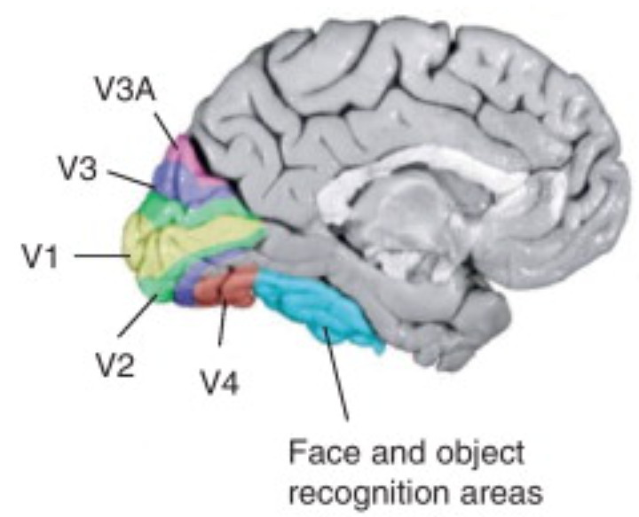
Example – the human visual system
Multi-layered
  Primary visual cortex (v1) – spatial information - spatial frequencies and orientations (also color), Secondary visual cortex (V2) – visual association
  Visual area V3 – coherent motion of large patterns
  Visual area V4 – tuned for object features of medium complexity
  Middle temporal visual area (V5) – perception of motion
  FFA (fusiform face area)

Slide 13
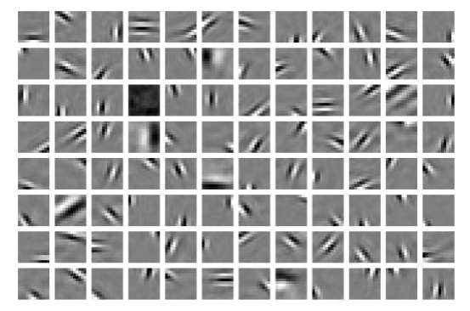
V1 type representations can be learned using sparse coding…
As an example of this type of learning, consider a multi-layered representation where layer 1 creates sparse features using a learning approach that preferred sparse weights:
It turns out that this is very similar to the representation of visual stimuli in V1
In order to create this representation you need a LOT of training data
This representation (often included in deep learning) can be learned using a CNN (convolutional neural net) but I preferred a more direct approach from Olshausen and Field:
http://www.nature.com/articles/381607a0
or ICA…

Slide 14
Deep Learning paradigm detail
use a cascade of multiple layers of nonlinear processing units for feature extraction and transformation. Each successive layer uses the output from the previous layer as input.
learn multiple levels of representations that correspond to different levels of abstraction; the levels form a hierarchy of concepts.
use some form of gradient descent for training via backpropagation.
I agree with the above (from Wikipedia) minus the last statement. Why must the learning use backprop?
It seems that the neural network community have recently found a justification for their approach and the multi-layered deep learning model (along with its neurological motivation) was well-suited to an ANN implementation
I prefer to see deep learning more broadly – that is that the paradigm doesn’t imply the implementation.

Slide 15
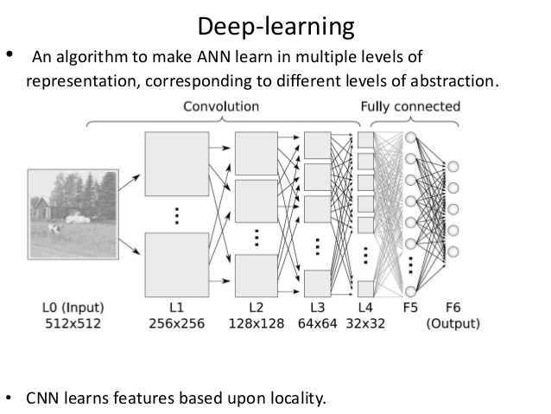
Typical Deep Learning Structure

Slide 16
Advantages / Disadvantages
Advantages
  Works quite well, provided you have a LOT of training data
  Biological motivation
Disadvantages
  Lack of theory surrounding the methods
  Issues with convergence (does it converge, and to what?)
  Black box

